Slide 1
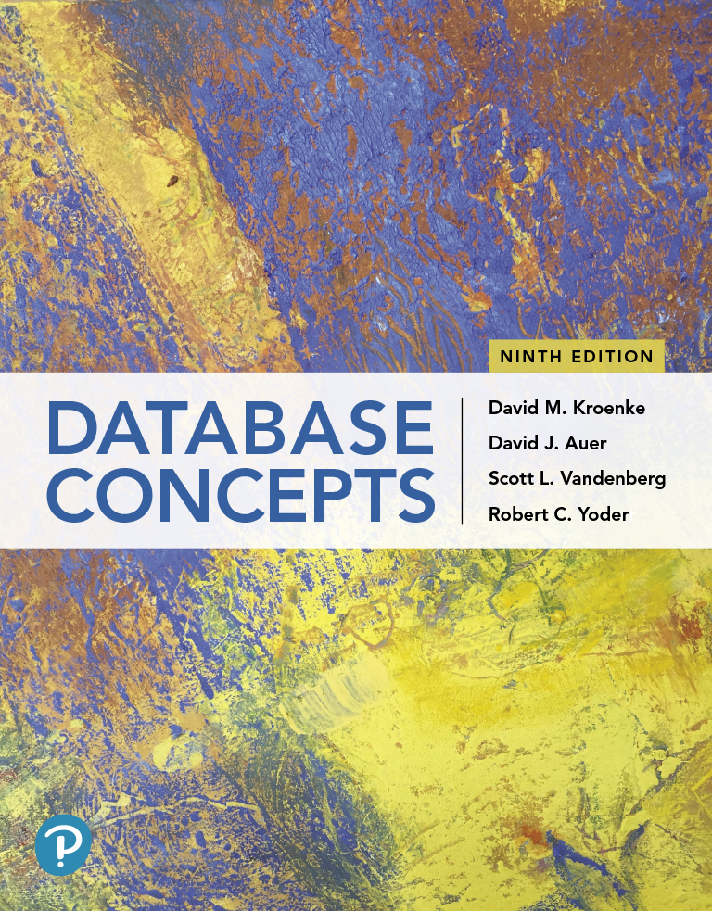
Database Concepts
Ninth Edition
Chapter 3
Structured Query Language
Copyright © 2020, 2017, 2015 Pearson Education, Inc. All Rights Reserved
Notes:
If this PowerPoint presentation contains mathematical equations, you may need to check that your computer has the following installed:
1) Math Type Plugin
2) Math Player (free versions available)
3) NVDA Reader (free versions available)

Slide 2
Learning Objectives
Learn basic SQL statements for creating database structures
Learn basic SQL statements for adding data to a database
Learn basic SQL SELECT statements and options for processing a single table
Learn basic SQL SELECT statements for processing multiple tables with subqueries
Learn basic SQL SELECT statements for processing multiple tables with joins
Learn basic SQL statements for modifying and deleting data from a database
Learn basic SQL statements for modifying and deleting database tables and constraints

Slide 3
Structured Query Language
Learn basic SQL statements for creating database structures
Structured Query Language (SQL) is not a complete programming language; rather, it is a data sublanguage
Developed by IBM in the late 1970’s
Endorsed and adopted by ANSI in 1992
Endorsed as a standard by the International Organization for Standardization (ISO)
It is text oriented
Can be used by MS Access using Query by Example (QBE)

Slide 4
SQL Statement Categories
Learn basic SQL statements for creating database structures
SQL statement categories are as follows:
Data definition language (DDL)
Statements used to create database structures
Data manipulation language (DML)
Statements used to query, insert, modify and delete data
SQL/Persistent stored modules (SQL/PSM)
Statements to extend SQL by adding procedural programming capabilities
Transaction control language (TCL)
Statements used to mark transaction boundaries
Data control language (DCL)
Statements used to grant and revoke database permissions

Slide 5
Wedgewood Pacific Example
Learn basic SQL statements for creating database structures
This chapter uses the Wedgewood Pacific (WP) company as an example.
Founded in 1957 in Seattle, WA
Manufacture and sell consumer drone aircraft
In January, 2018, the FAA said that over one million drones had been registered
WP’s database has four tables (Department, Employee, Project, and Assignment)

Slide 6
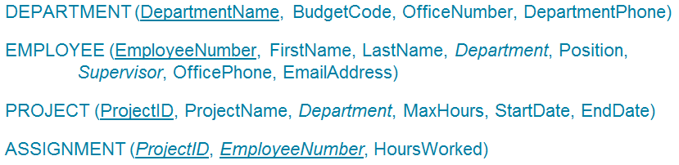
Wedgewood Pacific Relations
Learn basic SQL statements for creating database structures
The following relations are used for the Wedgewood Pacific (WP) example used in this chapter:

Slide 7
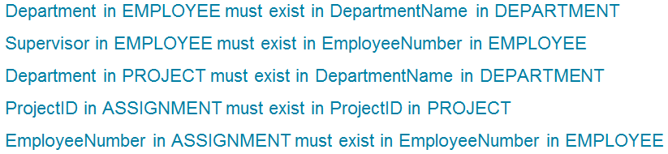
WP’s Referential Integrity Constraints
Learn basic SQL statements for creating database structures
A referential integrity constraint is used to link (or reference) relations. This means that a foreign key in a relation must also exist in the relation in which it serves as the primary key. WP’s referential integrity constraints:

Slide 8
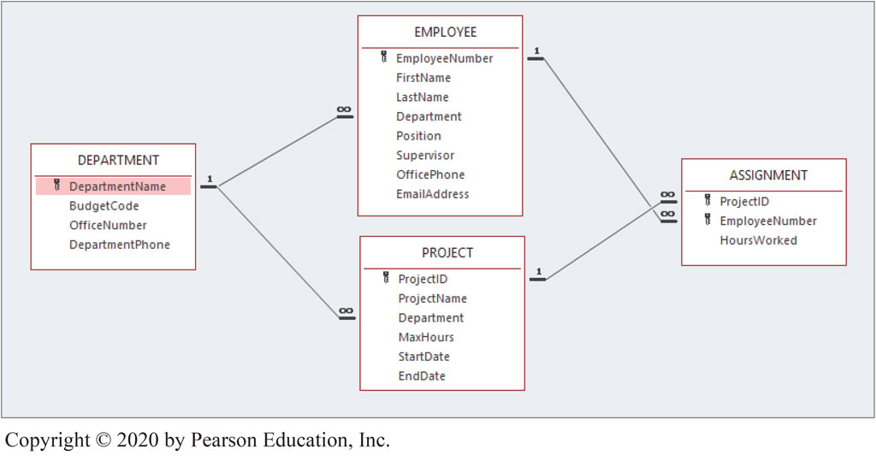
Figure 3.1(a) Database Column Characteristics for the WP Database
Access 2019, Windows 10, Microsoft Corporation

Slide 9
Figure 3.1(b) DEPARTMENT Table
Column Name | Type | Key | Required | Remarks
DepartmentName | Short Text (35) | Primary Key | Yes | Blank
BudgetCode | Short Text (30) | No | Yes | Blank
OfficeNumber | Short Text (15) | No | Yes | Blank
DepartmentPhone | Short Text (12) | No | Yes | Blank

Slide 10
Figure 3.1(c) EMPLOYEE Table
Column Name | Type | Key | Required | Remarks
EmployeeNumber | AutoNumber | Primary Key | Yes | Surrogate Key
FirstName | Short Text (25) | No | Yes | Blank
LastName | Short Text (25) | No | Yes | Blank
Department | Short Text (35) | Foreign Key | Yes | Links to DepartmentName in DEPARTMENT
Position | Short Text (35) | No | No | Blank
Supervisor | Number | Foreign Key | No | Long Integer. Links to EmployeeNumber in EMPLOYEE
OfficePhone | Short Text (12) | No | No | Blank
EmailAddress | Short Text (100) | No | Yes | Blank

Slide 11
Figure 3.1(d) PROJECT Table
ColumnName | Type | Key | Required | Remarks
ProjectID | Number | Primary Key | Yes | Long Integer
ProjectName | Short Text (50) | No | Yes | Blank
Department | Short Text (35) | Foreign Key | Yes | Links to DepartmentName in DEPARTMENT
MaxHours | Number | No | Yes | Double
StartDate | Date | No | No | Blank
EndDate | Date | No | No | Blank

Slide 12
Figure 3.1(e) ASSIGNMENT Table
Column Name | Type | Key | Required | Remarks
ProjectID | Number | Primary Key, Foreign Key | Yes | Long Integer Links to ProjectID in PROJECT
EmployeeNumber | Number | Primary Key, Foreign Key | Yes | Long Integer Links to EmployeeNumber in EMPLOYEE
HoursWorked | Number | No | No | Double

Slide 13
Figure 3.2(a) DEPARTMENT Table
Sample Data for the WP Database
DepartmentName | BudgetCode | OfficeNumber | DepartmentPhone
Administration | BC-100-10 | BLDG01-210 | 360-285-8100
Legal | BC-200-10 | BLDG01-220 | 360-285-8200
Human Resources | BC-300-10 | BLDG01-230 | 360-285-8300
Finance | BC-400-10 | BLDG01-110 | 360-285-8400
Accounting | BC-500-10 | BLDG01-120 | 360-285-8405
Sales and Marketing | BC-600-10 | BLDG01-250 | 360-285-8500
InfoSystems | BC-700-10 | BLDG02-210 | 360-285-8600
Research and Development | BC-800-10 | BLDG02-250 | 360-285-8700
Production | BC-900-10 | BLDG02-110 | 360-285-8800

Slide 14
Figure 3.2(b) Sample Data for the WP Database: EMPLOYEE Table (1 of 2)
Employee Number | FirstName | LastName | Department | Position | Supervisor | OfficePhone | EmailAddress
1 | Mary | Jacobs | Administration | C E O |  | 360-285-8110 | Mary.Jacobs@WP.com
2 | Rosalie | Jackson | Administration | Admin Assistant | 1 | 360-285-8120 | Rosalie.Jackson@WP.com
3 | Richard | Bandalone | Legal | Attorney | 1 | 360-285-8210 | Richard.Bandalone@ WP.com
4 | George | Smith | Human Resources | HR3 | 1 | 360-285-8310 | George.Smith@WP.com
5 | Alan | Adams | Human Resources | HR1 | 4 | 360-285-8320 | Alan.Adams@WP.com
6 | Ken | Evans | Finance | CFO | 1 | 360-285-8410 | Ken.Evans@WP.com
7 | Mary | Abernathy | Finance | FA3 | 6 | 360-285-8420 | Mary.Abernathy@WP.com
8 | Tom | Caruthers | Accounting | FA2 | 6 | 360-285-8430 | Tom.Caruthers@WP.com
9 | Heather | Jones | Accounting | FA2 | 6 | 360-285-8440 | Heather.Jones@WP.com
10 | Ken | Numoto | Sales and Marketing | SM3 | 1 | 360-285-8510 | Ken.Numoto@WP.com

Slide 15
Figure 3.2(b) Sample Data for the WP Database: EMPLOYEE Table (2 of 2)
Employee Number | FirstName | LastName | Department | Position | Supervisor | OfficePhone | EmailAddress
11 | Linda | Granger | Sales and Marketing | SM2 | 10 | 360-285-8520 | Linda.Granger@WP.com
12 | James | Nestor | InfoSystems | CIO | 1 | 360-285-8610 | James.Nestor@WP.com
13 | Rick | Brown | InfoSystems | IS2 | 12 | Blank | Rick.Brown@WP.com
14 | Mike | Nguyen | Research and Development | CTO | 1 | 360-285-8710 | Mike.Nguyen@WP.com
15 | Jason | Sleeman | Research and Development | RD3 | 14 | 360-285-8720 | Jason.Sleeman@WP.com
16 | Mary | Smith | Production | OPS3 | 1 | 360-285-8810 | Mary.Smith@WP.com
17 | Tom | Jackson | Production | OPS2 | 16 | 360-285-8820 | Tom.Jackson@WP.com
18 | George | Jones | Production | OPS2 | 17 | 360-285-8830 | George.Jones@WP.com
19 | Julia | Hayakawa | Production | OPS1 | 17 | Blank | Julia.Hayakawa@WP.com
20 | Sam | Stewart | Production | OPS1 | 17 | Blank | Sam.Stewart@WP.com

Slide 16
Figure 3.2(c) Sample Data for the WP Database: PROJECT Table
ProjectID | ProjectName | Department | MaxHours | StartDate | EndDate
1000 | 2019 Q3 Production Plan | Production | 100.00 | 05/10/19 | 06/15/19
1100 | 2019 Q3 Marketing Plan | Sales and Marketing | 135.00 | 05/10/19 | 06/15/19
1200 | 2019 Q3 Portfolio Analysis | Finance | 120.00 | 07/05/19 | 07/25/19
1300 | 2019 Q3 Tax Preparation | Accounting | 145.00 | 08/10/19 | 10/15/19
1400 | 2019 Q4 Production Plan | Production | 100.00 | 08/10/19 | 09/15/19
1500 | 2019 Q4 Marketing Plan | Sales and Marketing | 135.00 | 08/10/19 | 09/15/19
1600 | 2019 Q4 Portfolio Analysis | Finance | 140.00 | 10/05/19 | Blank

Slide 17
Figure 3.2(d) Sample Data for the WP Database: ASSIGNMENT Table
ProjectID | EmployeeNumber | HoursWorked
1000 | 1 | 30.00
1000 | 6 | 50.00
1000 | 10 | 50.00
1000 | 16 | 75.00
1000 | 17 | 75.00
1100 | 1 | 30.00
1100 | 6 | 75.00
Partial List of Data

Slide 18
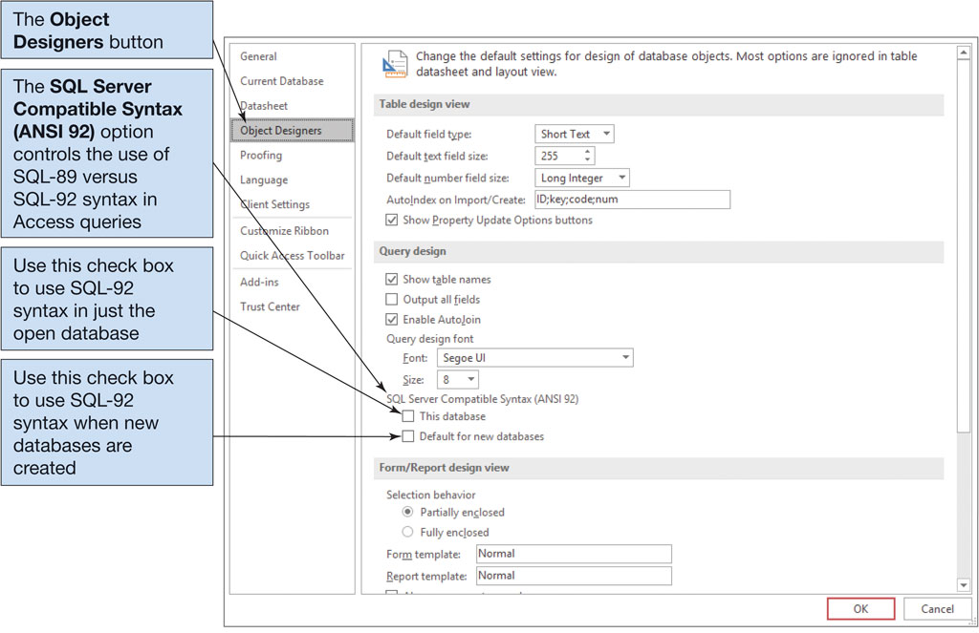
Figure 3.3 The Microsoft Access 2019 Options Object Designers Page
Access 2019, Windows 10, Microsoft Corporation

Slide 19
SQL for Data Definition Language (DDL)
Learn basic SQL statements for creating database structures
The SQL data definition statements include:
CREATE
to create database objects
ALTER
to modify the structure and/or characteristics of database objects
DROP
to delete database objects
TRUNCATE
to delete table data while keeping the structure

Slide 20
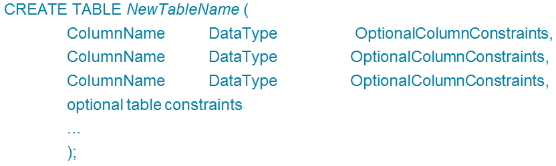
SQL CREATE TABLE Statement
Learn basic SQL statements for creating database structures
The SQL CREATE TABLE statement format is as follows:

Slide 21
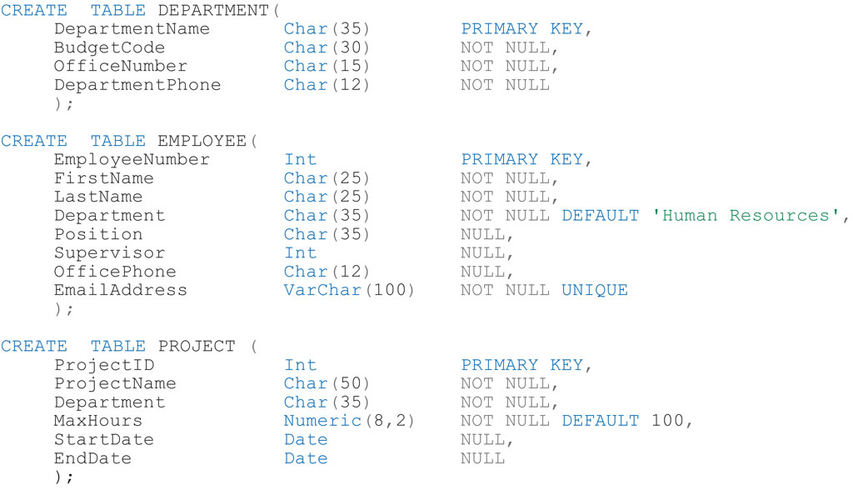
Figure 3.4 SQL CREATE TABLE Statements

Slide 22
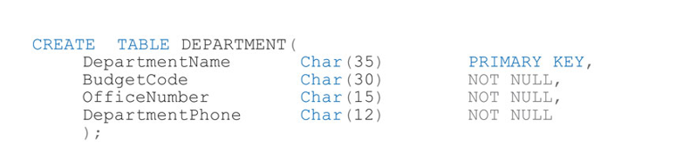
Create a new database:
Create the following table using SQL in the query window of MS Access:

Slide 23
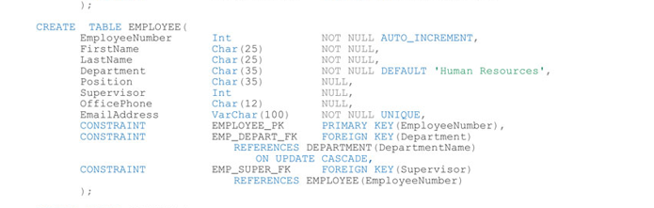
Create the second table using the following method.
DO NOT ADD THE AUTO INCREMENT

Slide 24
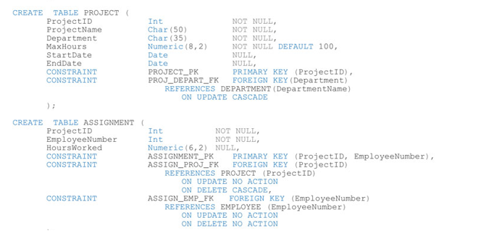
Create the remaining tables

Slide 25
Data Types
There are many data types available in all DBMS products. To see these you can refer to page 146 in your text.
Char for character
Numeric for numeric data
Dates for date

Slide 26
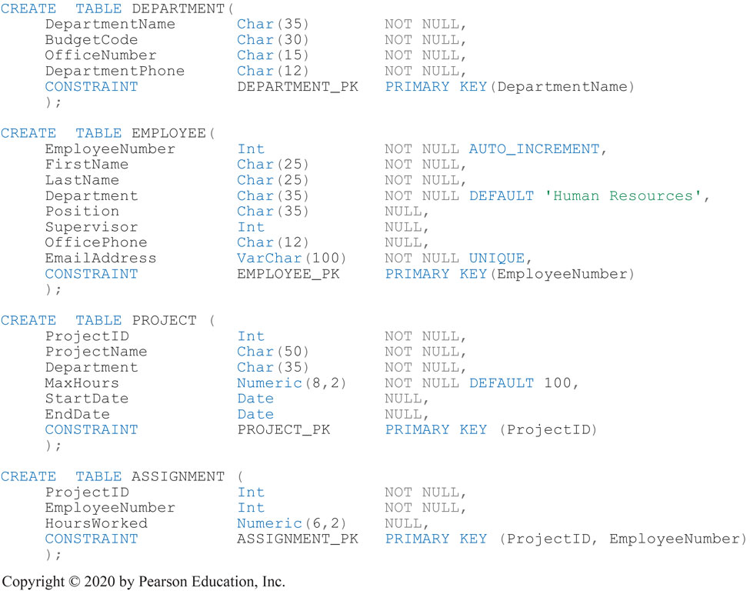
Figure 3.6 Creating Primary Keys with SQL Table Constraints

Slide 27
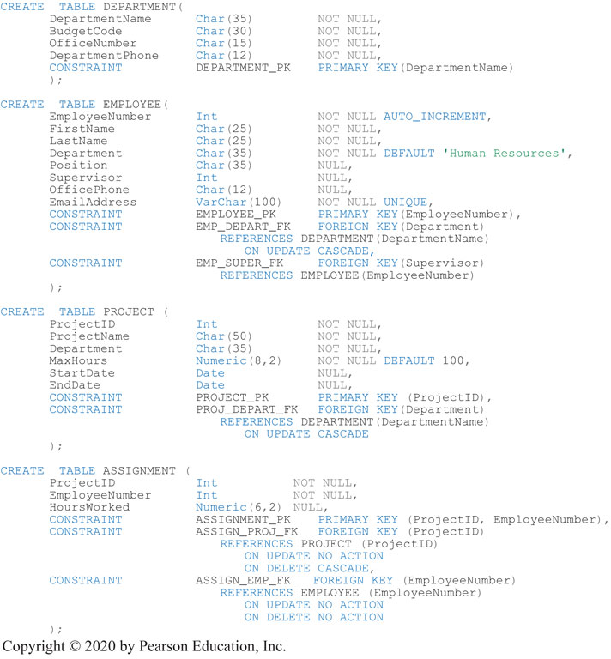
Figure 3.7 Creating Foreign Keys with SQL Table Constraints

Slide 28
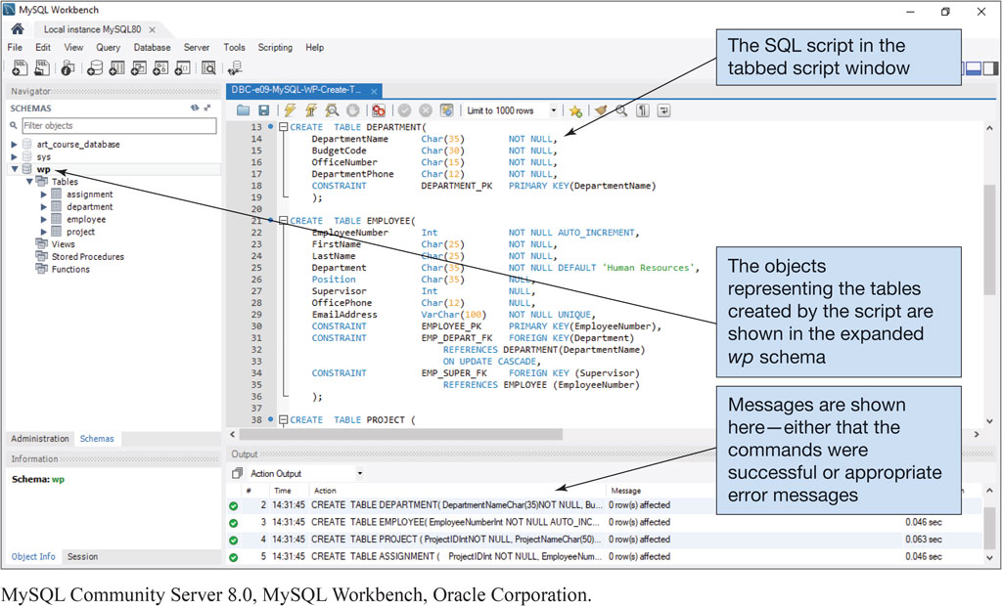
Figure 3.8 Processing the SQL CREATE TABLE Statements Using MySQL 8.0
MySQL Community Server 8.0, MySQL Workbench, Oracle Corporation

Slide 29
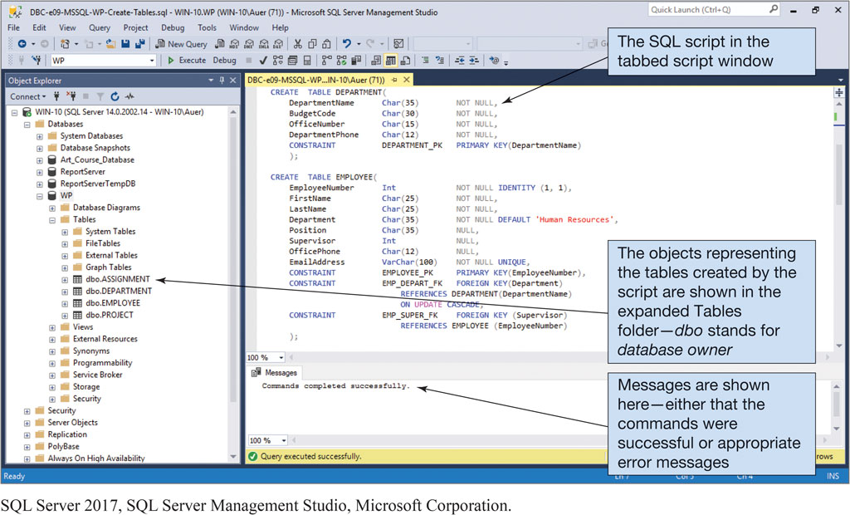
Figure 3.9 Processing the SQL CREATE TABLE Statements Using MS SQL Server 2017
SQL Server 2017, SQL Server Management Studio, Microsoft Corporation

Slide 30
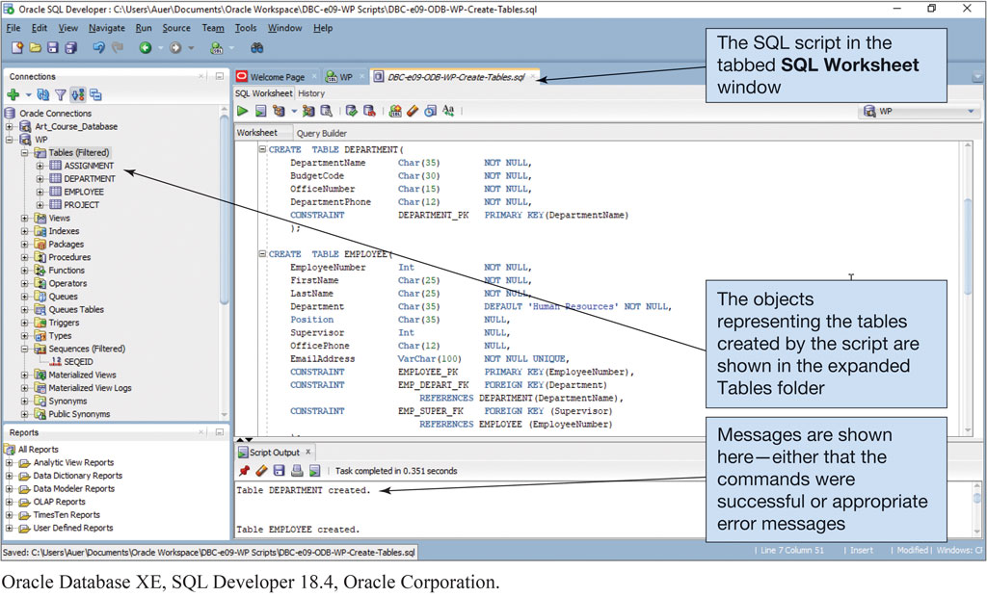
Figure 3.10 Processing the SQL CREATE TABLE Statements Using Oracle Database XE
Oracle Database XE, SQL Developer 18.4, Oracle Corporation

Slide 31
SQL for Data Manipulation (DML) – Inserting Data
SQL DML is used to query databases and to modify data in the tables.
There are three possible data modification operations:
INSERT (adding data to a relation)
UPDATE (modifying data in a relation)
DELETE (deleting data in a relation)

Slide 32
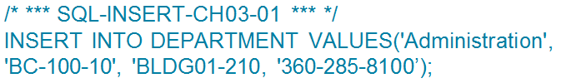
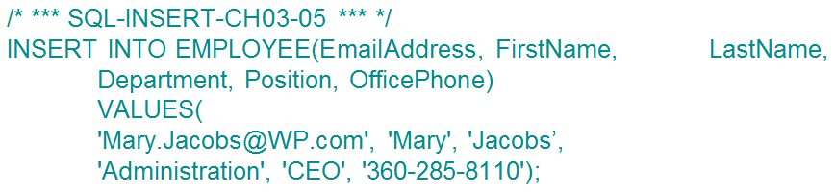
Inserting Data
Learn basic SQL SELECT for adding data to a database
The order of the columns on the INSERT command does not matter as long as the values match the order of the columns as seen below.

Slide 33
The SQL Query Framework
Learn basic SQL SELECT statements and options for processing a single table
The basic framework for the SQL Query statement has three statements as follows:
the SQL SELECT clause
specifies which columns are to be listed in the query results
the SQL FROM clause
specifies which tables are to be used in the query
the SQL WHERE clause
specifies which rows are to be listed in the query results

Slide 34

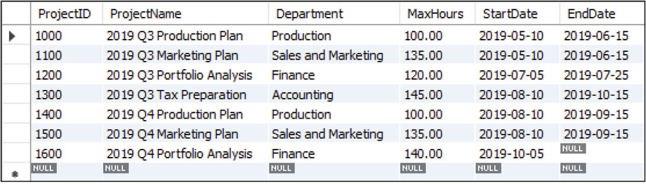
Reading Specified Columns from a Single Table
Learn basic SQL SELECT statements and options for processing a single table
MySQL Community Server 8.0, MySQL Workbench, Oracle Corporation

Slide 35
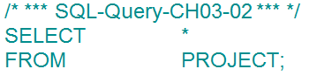
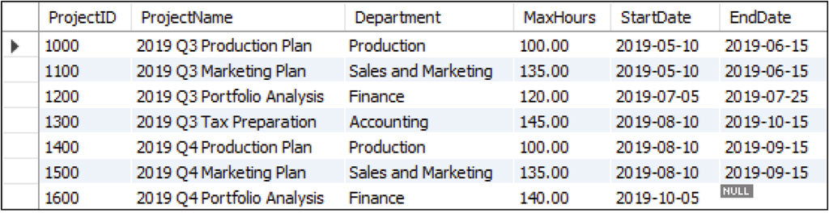
Single Table Queries Displaying All Columns
Learn basic SQL SELECT statements and options for processing a single table
MySQL Community Server 8.0, MySQL Workbench, Oracle Corporation

Slide 36

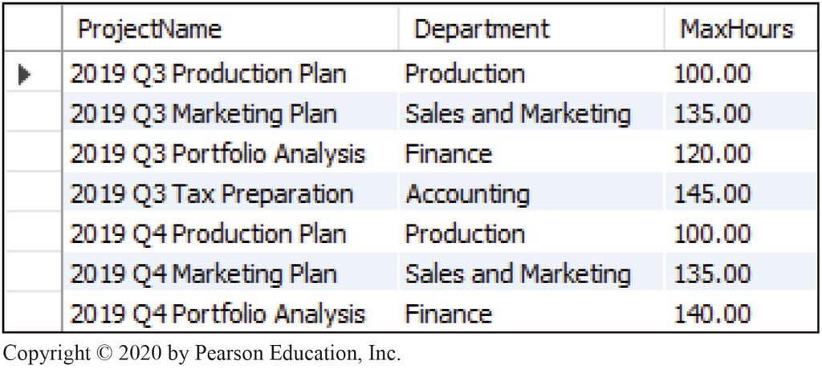
Single Table Queries Specifying Column Order
Learn basic SQL SELECT statements and options for processing a single table
MySQL Community Server 8.0, MySQL Workbench, Oracle Corporation

Slide 37
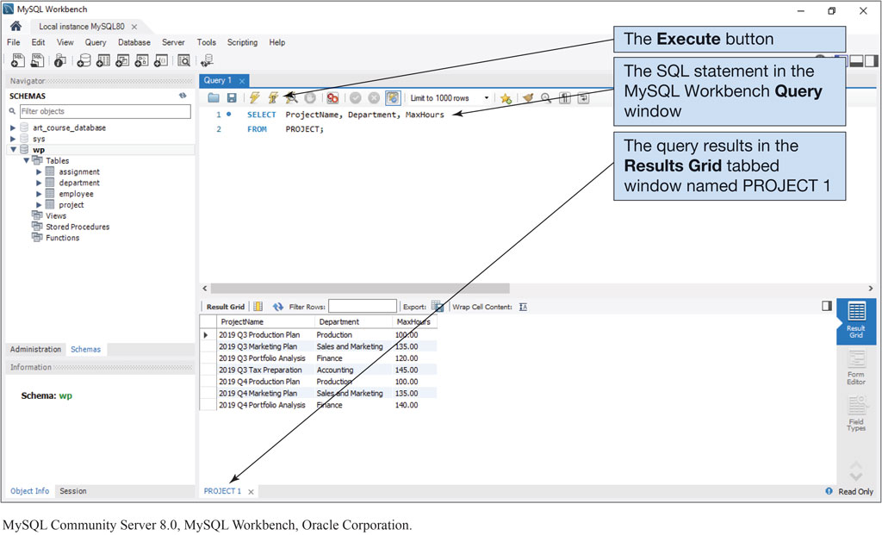
Figure 3.12 SQL Query Results in the MySQL Workbench
MySQL Community Server 8.0, MySQL Workbench, Oracle Corporation

Slide 38
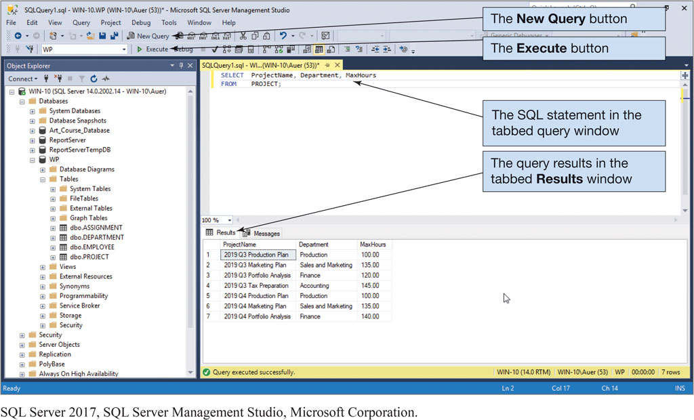
Figure 3.13 SQL Query Results in the Microsoft SQL Server Management Studio
SQL Server 2017, SQL Server Management Studio, Microsoft Corporation

Slide 39
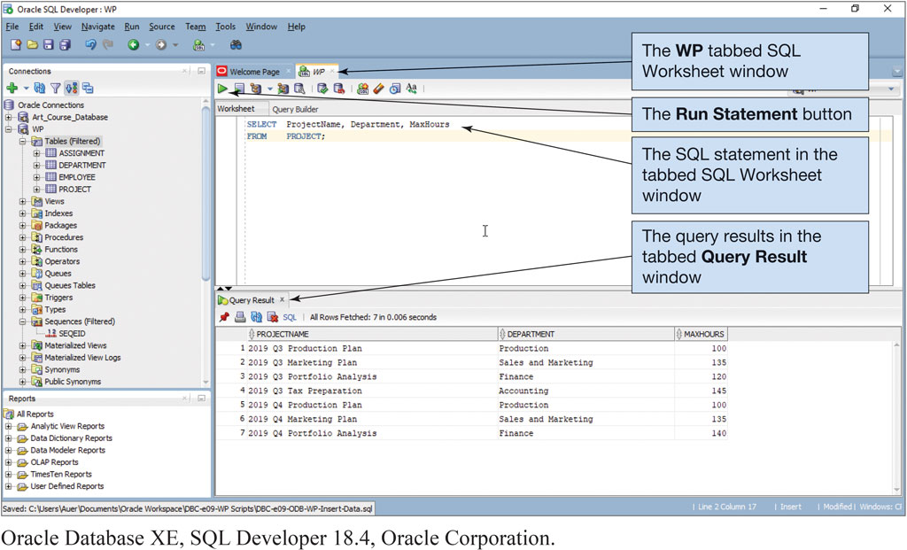
Figure 3.14 SQL Query Results in the Oracle SQL Developer
Oracle Database XE, SQL Developer 18.4, Oracle Corporation

Slide 40

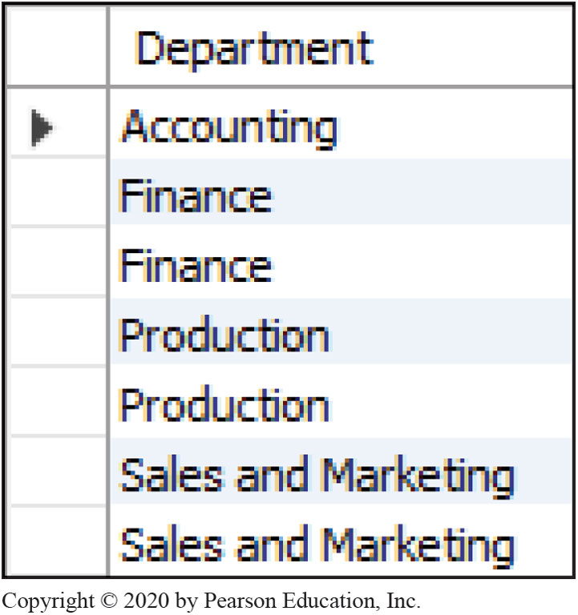
Reading Specified Rows from a Single Table
Learn basic SQL SELECT statements and options for processing a single table
MySQL Community Server 8.0, MySQL Workbench, Oracle Corporation

Slide 41

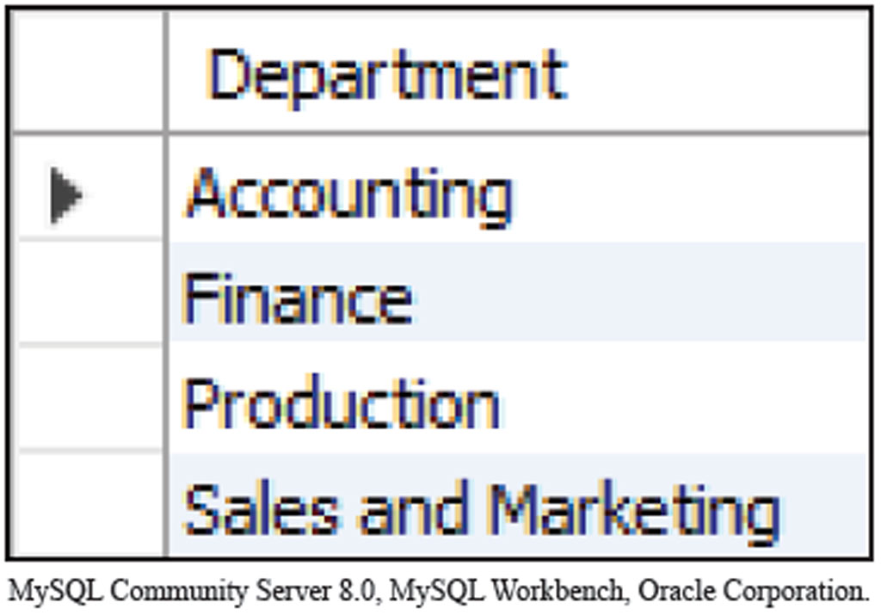
Single Table Queries The DISTINCT Keyword
Learn basic SQL SELECT statements and options for processing a single table
MySQL Community Server 8.0, MySQL Workbench, Oracle Corporation

Slide 42
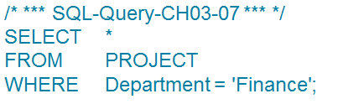
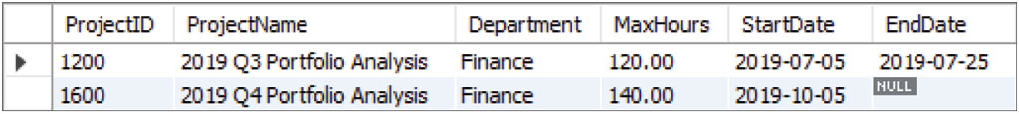
Single Table Queries The WHERE Clause
Learn basic SQL SELECT statements and options for processing a single table
MySQL Community Server 8.0, MySQL Workbench, Oracle Corporation

Slide 43
Figure 3.15 SQL Comparison Operators
SQL Comparison Operators
Operator | Meaning
= | Is equal to
<> | Is NOT Equal to
< | Is less than
> | Is greater than
<= | Is less than OR equal to
>= | Is greater than OR equal to
IN | Is equal to one of a set of values
NOT IN | Is NOT equal to any of a set of values
BETWEEN | Is within a range of numbers (includes the end points)
NOT BETWEEN | Is NOT within a range of numbers (includes the end points)
LIKE | Matches a set of characters
NOT LIKE | Does NOT match a set of characters
IS NULL | Is equal to NULL
IS NOT NULL | Is NOT equal to NULL

Slide 44
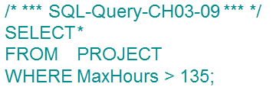
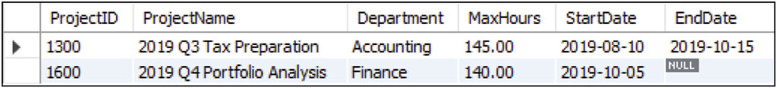
Single Table Queries Using Comparison Operators
Learn basic SQL SELECT statements and options for processing a single table
MySQL Community Server 8.0, MySQL Workbench, Oracle Corporation

Slide 45
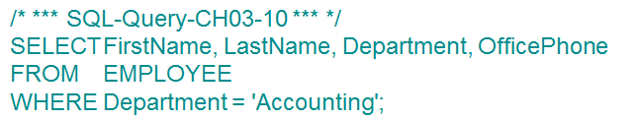
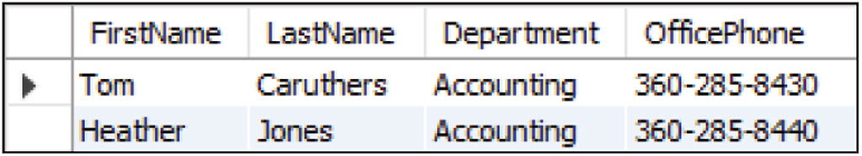
Single Table Queries Reading Specified Columns and Rows
Learn basic SQL SELECT statements and options for processing a single table
MySQL Community Server 8.0, MySQL Workbench, Oracle Corporation

Slide 46
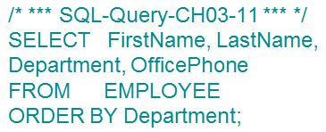
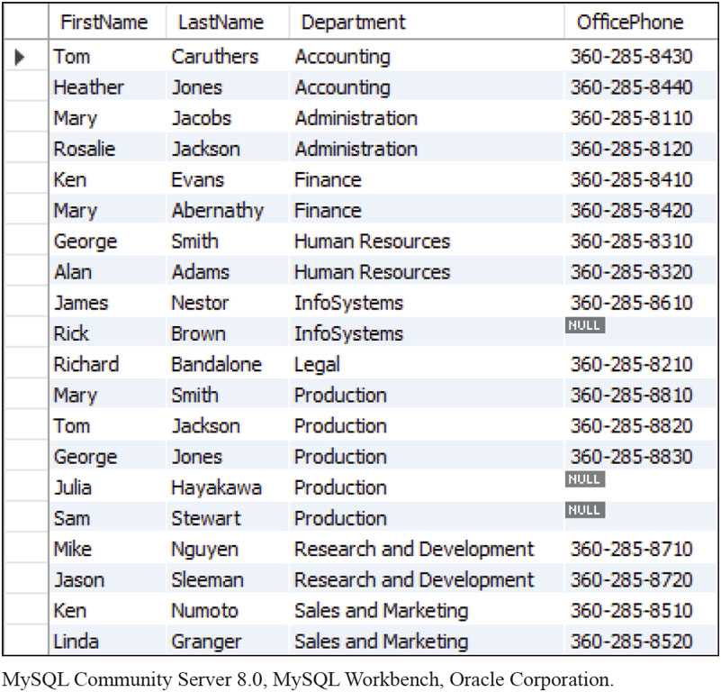
Single Table Queries Sorting the Results of a Query
Learn basic SQL SELECT statements and options for processing a single table
By default, SQL Server sorts in ascending order. If you need the sort in descending order it would be:
ORDER BY Department DESC;

Slide 47
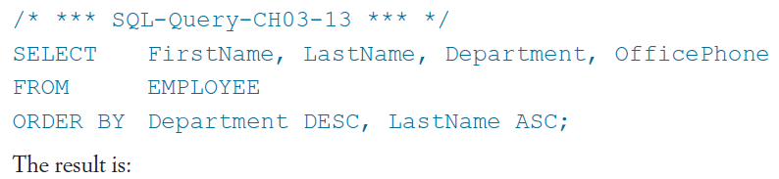
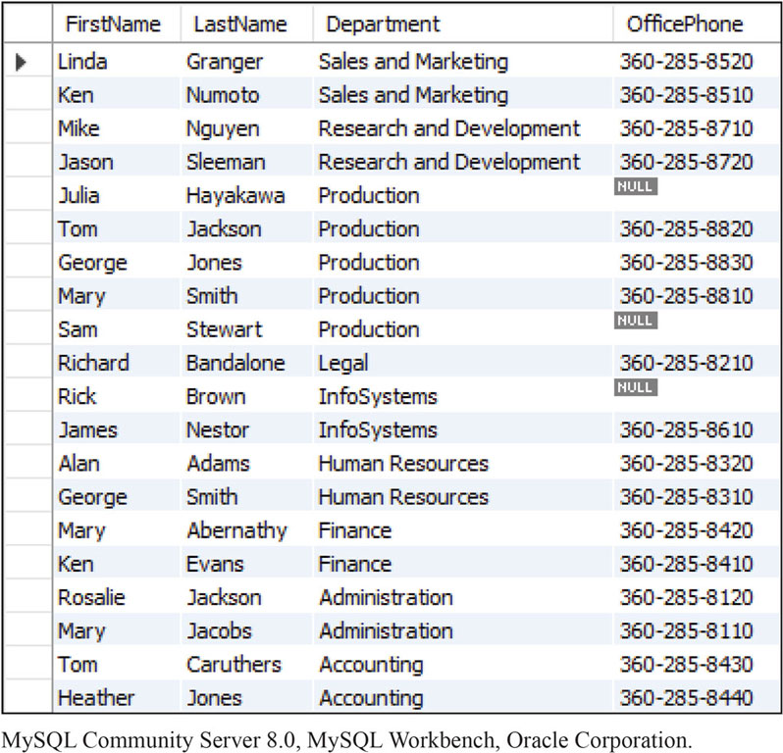
Single Table Queries Sorting by Multiple Columns
Learn basic SQL SELECT statements and options for processing a single table
MySQL Community Server 8.0, MySQL Workbench, Oracle Corporation.

Slide 48
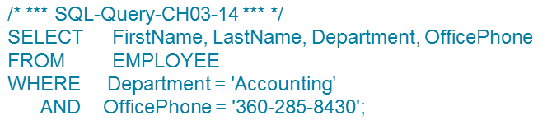
Single Table Queries SQL WHERE Clause Options
Learn basic SQL SELECT statements and options for processing a single table
Three options for the SQL WHERE clauses are:
compound clauses
ranges
wildcards
An example of the compound clause is below:

Slide 49
Figure 3.16 SQL Logical Operators
SQL Logical Operators
Operator | Meaning
AND | Both arguments are TRUE
OR | One or the other or both of the arguments are TRUE
NOT | Negates the associated operator

Slide 50
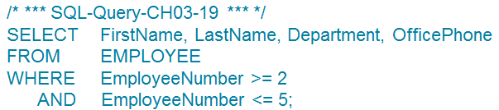
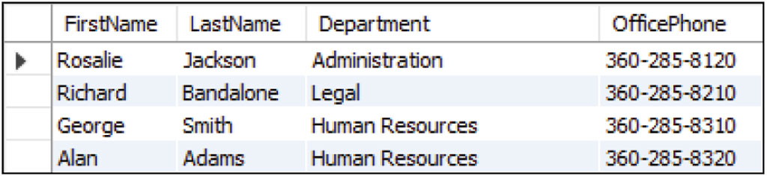
Single Table Queries: SQL WHERE Clauses Using Ranges of Values
Learn basic SQL SELECT statements and options for processing a single table
MySQL Community Server 8.0, MySQL Workbench, Oracle Corporation.

Slide 51
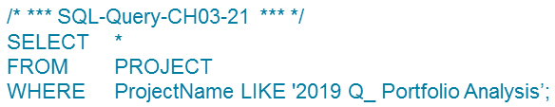
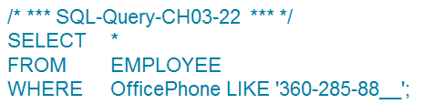
Single Table Queries: SQL WHERE Clauses Using Wildcards
Learn basic SQL SELECT statements and options for processing a single table
When using an underscore it means that any character can occur in the spot occupied by the underscore.
Notice below that an underscore is used for each space needed.

Slide 52
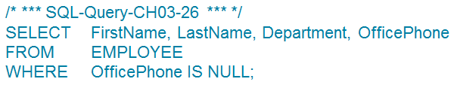
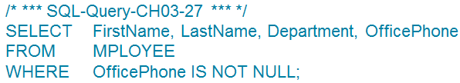
Single Table Queries: SQL WHERE Clauses That Use NULL Values
Learn basic SQL SELECT statements and options for processing a single table
To include or exclude rows that contain NULL values, we use the IS NULL or IS NOT NULL comparison values.

Slide 53
Single Table Queries: SQL Queries That Perform Calculations
Learn basic SQL SELECT statements and options for processing a single table
It is possible to perform certain types of calculations in SQL query statements.
One group of calculations involves the use of SQL built-in functions.
Another group involves simple arithmetic operations on the columns in the SELECT statement.

Slide 54
Figure 3.17 SQL Built-in Aggregate Functions
SQL Built-in Aggregate Functions
Function | Meaning
COUNT(*) | Count the number of rows in the table
COUNT ({Name}) | Count the number of rows in the table where column {Name} IS NOT NULL
SUM | Calculate the sum of all values (numeric columns only)
AVG | Calculate the average of all values (numeric columns only)
MIN | Calculate the minimum value of all values
MAX | Calculate the maximum value of all values

Slide 55
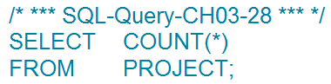

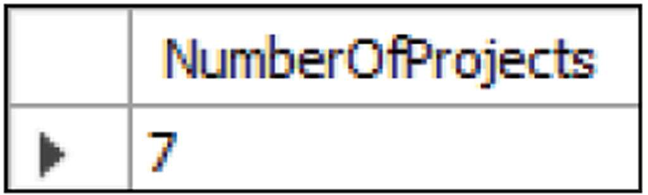
Single Table Queries: Using SQL Built-in Aggregate Functions
Learn basic SQL SELECT statements and options for processing a single table

Slide 56
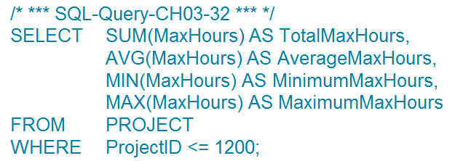
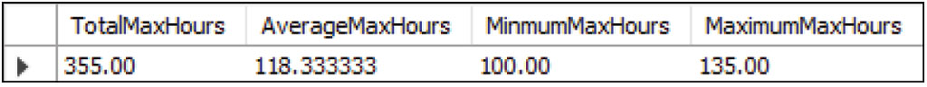
Single Table Queries: Using Multiple Aggregate Functions in an SQL Statement
Learn basic SQL SELECT statements and options for processing a single table

Slide 57

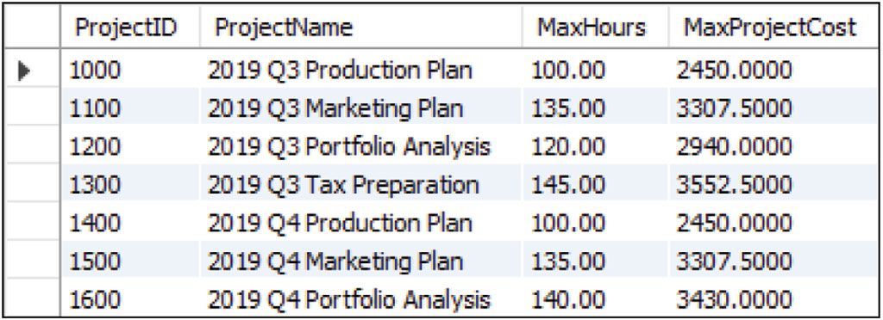
Single Table Queries: Using Expressions in SQL SELECT Statements
Learn basic SQL SELECT statements and options for processing a single table

Slide 58
Single Table Queries: Grouping Rows Using SQL SELECT Statements
Learn basic SQL SELECT statements and options for processing a single table
In SQL, you can use the SQL GROUP BY clause to group rows by common values.
This is a powerful feature, but it can be difficult to understand.
What do we mean by a group? Consider the EMPLOYEE table in Figure 3.18 on the next slide, where we show the employees grouped by which department they work in.
Because there are 9 departments, we have the employees divided into 9 groups.

Slide 59
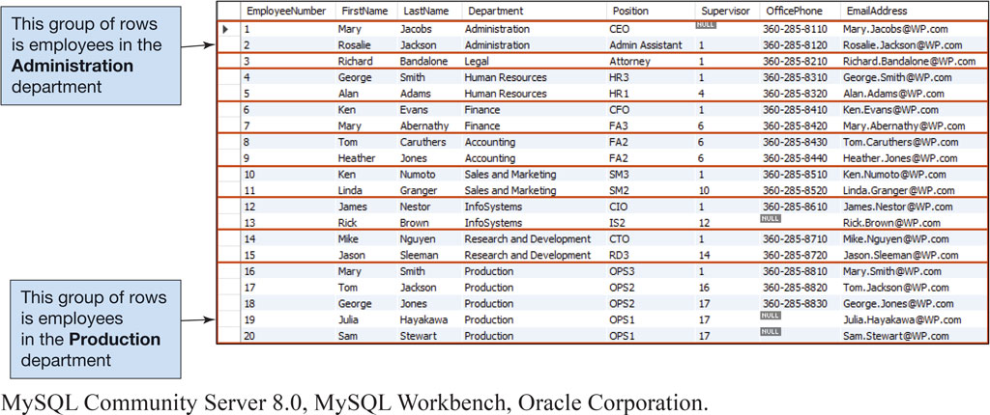
Figure 3.18 Department Groups in the EMPLOYEE Table
MySQL Community Server 8.0, MySQL Workbench, Oracle Corporation.

Slide 60
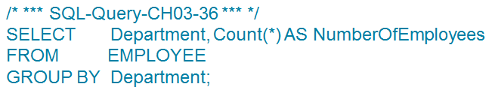

Single Table Queries: Using the GROUP BY Clause
Learn basic SQL SELECT statements and options for processing a single table
MySQL Community Server 8.0, MySQL Workbench, Oracle Corporation.

Slide 61


Single Table Queries: Using the GROUP BY Clause with the HAVING Clause
Learn basic SQL SELECT statements and options for processing a single table
MySQL Community Server 8.0, MySQL Workbench, Oracle Corporation.

Slide 62
Multiple Table Queries: SQL For Data Manipulation (DML)
Learn basic SQL SELECT Statements for processing multiple tables with subqueries
The queries considered so far have involved data from a single table. However, at times, more than one table must be processed to obtain the desired information. SQL provides two different techniques for querying data from multiple tables:
the SQL Subquery
the SQL Join

Slide 63


Multiple Table Queries: Querying with Subqueries
Learn basic S Q L SELECT Statements for processing multiple tables with subqueries
My S Q L Community Server 8.0, My S Q L Workbench, Oracle Corporation.

Slide 64

Figure 3.19 Using Primary Key and Foreign Key Values in the SQL WHERE Clause in an Implicit SQL JOIN
MySQL Community Server 8.0, MySQL Workbench, Oracle Corporation.

Slide 65


Multiple Table Queries: Querying with Joins (1 of 2)
Learn basic SQL SELECT Statements for processing multiple tables with Joins
MySQL Community Server 8.0, MySQL Workbench, Oracle Corporation.

Slide 66

Multiple Table Queries: Querying with Joins (2 of 2)
Learn basic SQL SELECT Statements for processing multiple tables with Joins
MySQL Community Server 8.0, MySQL Workbench, Oracle Corporation.

Slide 67

Multiple Table Queries: Using the JOIN ON with the GROUP BY
Learn basic SQL SELECT Statements for processing multiple tables with Joins
The JOIN ON syntax still requires a statement of primary key to foreign key as shown below:

Slide 68

Figure 3.22 Using Primary Key and Foreign Key Values in the SQL ON Clause in an Explicit SQL Join
MySQL Community Server 8.0, MySQL Workbench, Oracle Corporation.

Slide 69
Multiple Table Queries: Comparing Subqueries and Joins
Learn basic SQL SELECT Statements for processing multiple tables with Joins
Subqueries and joins both process multiple tables, but they differ slightly.
A subquery can only be used to retrieve data from the top table
A join can be used to obtain data from any number of tables.

Slide 70
Multiple Table Queries: SQL Inner Joins
Learn basic SQL SELECT Statements for processing multiple tables with Joins
SQL Inner Join is also referred to as an SQL equijoin.
An Inner Join only displays data from the rows that match based on join conditions:
if a row has a value that does not match the WHERE clause condition, that row will not be included in the join result

Slide 71




Figure 3.25 Types of SQL JOINS

Slide 72
SQL for Data Manipulation (DML)– Data Modification and Deletion
Learn basic SQL for modifying and deleting data from a database
The SQL DML contains commands for the three possible data modifications operations:
Insert
Modify
Delete

Slide 73


Modifying Data Example 1
Learn basic SQL for modifying and deleting data from a database
To see the results, we use the following command:
MySQL Community Server 8.0, MySQL Workbench, Oracle Corporation.

Slide 74

Modifying Data Example 2
Learn basic SQL for modifying and deleting data from a database

Slide 75

Deleting Data
Learn basic SQL for modifying and deleting data from a database
The example above is a valid statement, but note that if you fail to include the WHERE clause then you will have just deleted all records in the table.

Slide 76
SQL For Data Definition (DDL) – Table and Constraint Modification and Deletion
Learn basic SQL statements for modifying and deleting database tables and constraints
Two of the most useful data definition SQL statements are:
the SQL DROP TABLE statement
the SQL ALTER TABLE statement

Slide 77

The SQL DROP TABLE Statement
Learn basic SQL statements for modifying and deleting database tables and constraints

Slide 78

The SQL ALTER TABLE Statement
Learn basic SQL statements for modifying and deleting database tables and constraints

Slide 79

Copyright
This work is protected by United States copyright laws and is provided solely for the use of instructors in teaching their courses and assessing student learning. Dissemination or sale of any part of this work (including on the World Wide Web) will destroy the integrity of the work and is not permitted. The work and materials from it should never be made available to students except by instructors using the accompanying text in their classes. All recipients of this work are expected to abide by these restrictions and to honor the intended pedagogical purposes and the needs of other instructors who rely on these materials.
Notes:
If this slide was not included in the original PPT, it should be added.

